Slide 1


PUTTANNAIAH FOUNDATION
PRESENTS
FIN - A - THON
MENTORING PARTNER

Slide 2


TEAM DETAILS
TEAM NAME :SPARKERS
COLLEGE NAME :SIDDAGANGA INSTITUTE OF TECHNOLOGY
Team member 1 Name:Harshith Kumar H S
Stream: CSE
Team member 2 Name:Chandrahas Suresh Gaddi
Stream: CSE
Team member 3 Name:Deekshith Patel L.L
Stream: CSE
Team member 4 Name:Harsha D T
Stream: CSE
FIN - A - THON by Puttannaiah Foundation

Slide 3
PROBLEM STATEMENT
Empowering Rural Economies Through Agro -Nova
Problem Statement:
The challenges in rural entrepreneurship arise from limited access to finance, inadequate infrastructure, and poor digital connectivity. Low business literacy and weak market linkages further isolate rural entrepreneurs, reducing their competitiveness. Additionally, ineffective policy implementation and bureaucratic hurdles hinder their growth and sustainability.
Problem Quantification:
According to World Bank data, over 70% of rural entrepreneurs in developing countries lack access to formal financial services, leading to reliance on high-interest informal credit.
In India, only 15% of rural enterprises have access to institutional credit sources.
Causes of Our Problem statement:
Lack of Access to Financial Resources
Limited Education and Skill Development
FIN - A - THON by Puttannaiah Foundation

Slide 4

SOLUTION:
Detailed description on how the problem is to be solved.
1.Connecting Entrepreneurs and Funders: Entrepreneurs can register their ideas, location, and domain expertise on the platform, allowing funders to discover innovative projects in need of support. This helps solve the issue of limited access to finance and connects entrepreneurs to potential funding sources.
2. Data-Driven Success Prediction: Using machine learning models, the platform predicts the success probability of submitted ideas. This empowers entrepreneurs with valuable insights and helps funders make informed decisions, reducing risks and enhancing success rates.
3. Enhanced Market and Knowledge Access: The inclusion of "Insighters" provides entrepreneurs with access to related ideas, trends, and expert opinions, fostering innovation and knowledge sharing.
4. Simplified Communication and Approvals: Through Twilio API integration, the platform facilitates direct communication between funders and entrepreneurs, ensuring timely notifications and faster approvals.
5. Centralized User Interface: A unified dashboard for entrepreneurs, funders, and insighters provides an easy-to-use interface to streamline operations, making the process efficient and transparent.
FIN - A - THON by Puttannaiah Foundation

Slide 5
Expected Outcome:
Empowered Entrepreneurs: Increased opportunities for rural entrepreneurs to secure funding and support, leading to the successful launch and growth of their businesses.
Enhanced Funding Efficiency: Funders gain access to curated, high-potential ideas, reducing investment risks and fostering confidence in rural entrepreneurship.
Knowledge Sharing and Innovation: Rural entrepreneurs gain exposure to new trends, technologies, and business practices via expert insights.
Economic Development in Rural Areas: Creation of sustainable livelihoods, leading to reduced unemployment and migration from rural to urban areas.

Slide 6
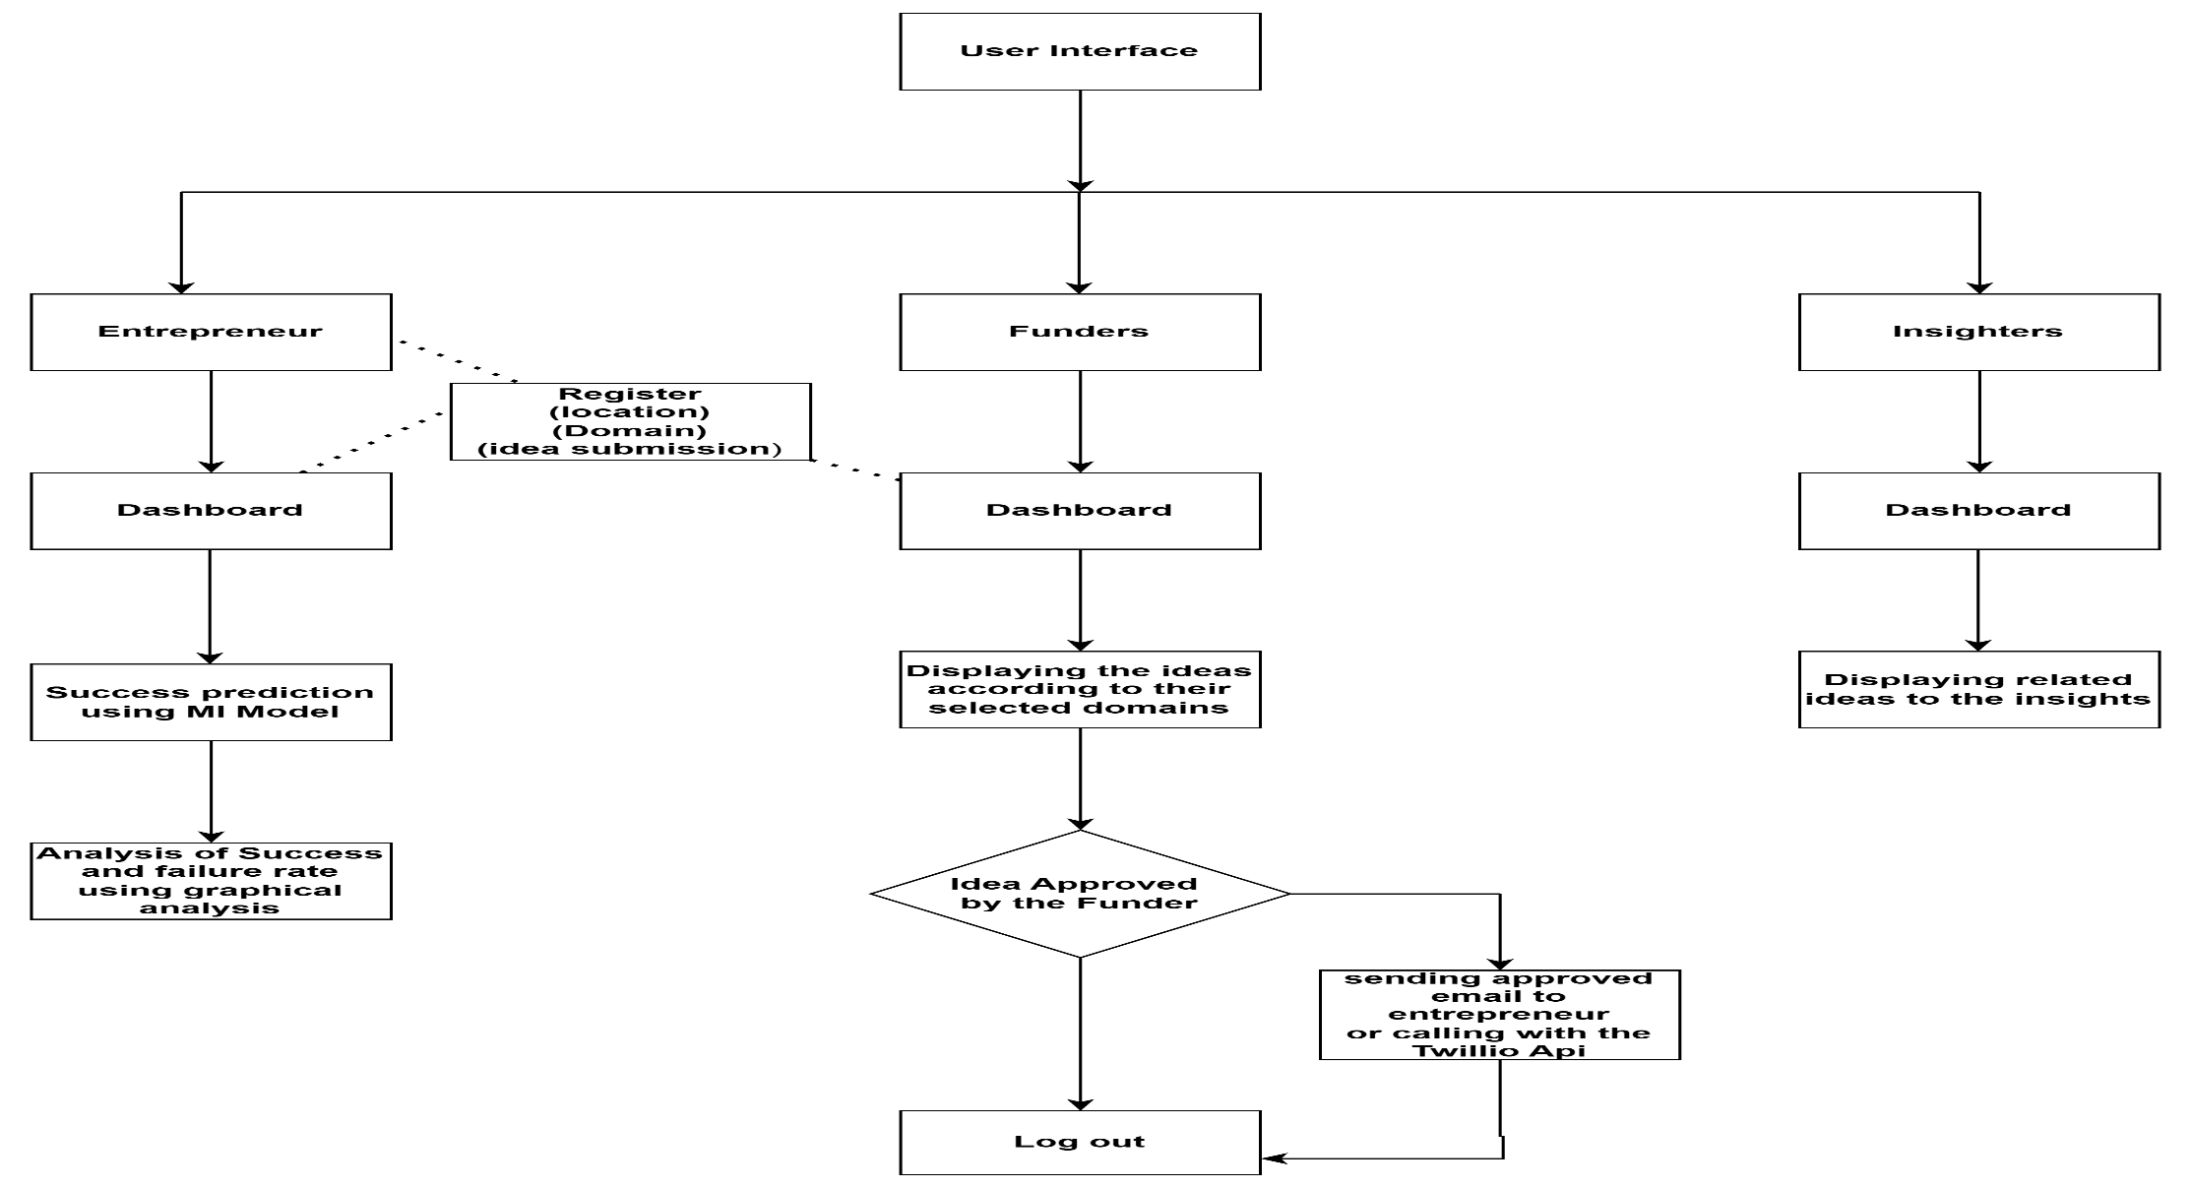
KEY FEATURES & TECHNICAL ARCHITECTURE
FIN - A - THON by Puttannaiah Foundation

Slide 7
Technologies used
Frontend- React.js
Backend- Node.js, Express.js, Mongo DB(database),Flask
Machine Learning Model- Random Forest Algorithm
Api: Twilio Api, Email js Api
Graphical Analysis : pie chart (chart.js)
The formula which is used to calculate the success prediction rate at particular location in ML Model for particular domain is:
Success Rate= Area X Population X Need Rate
No of already existed domains

Slide 8

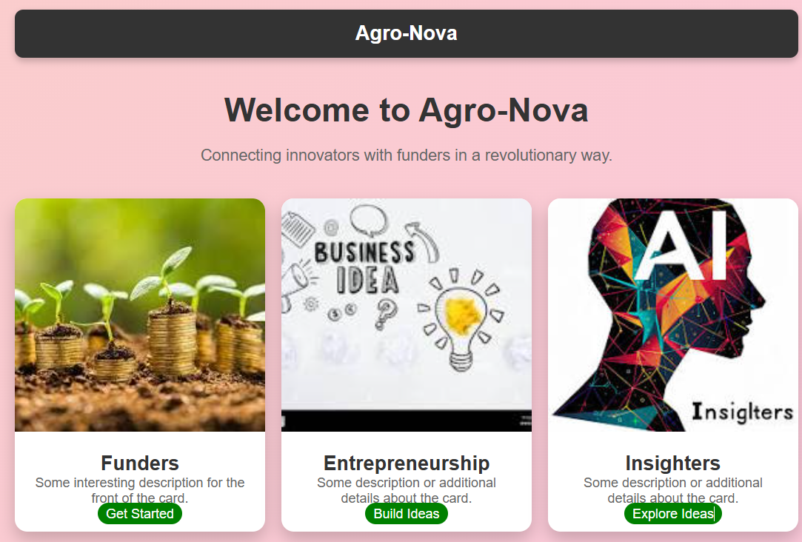
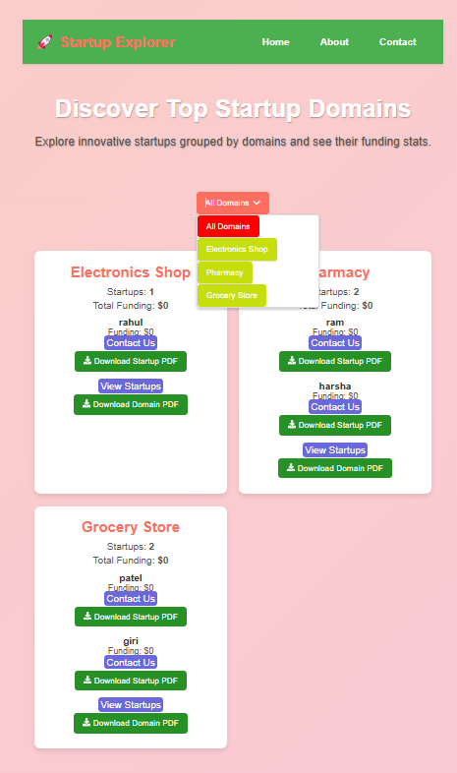
IMPLEMENTATION
Home Page
Funders Dashboard
FIN - A - THON by Puttannaiah Foundation

Slide 9
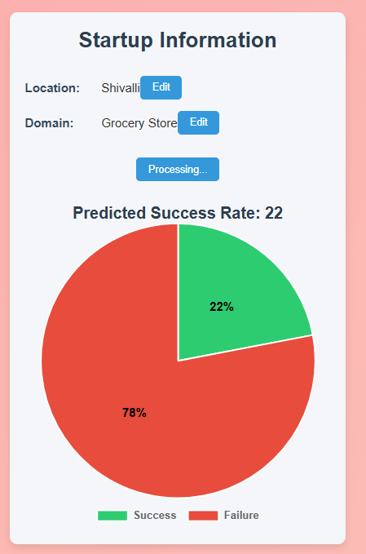
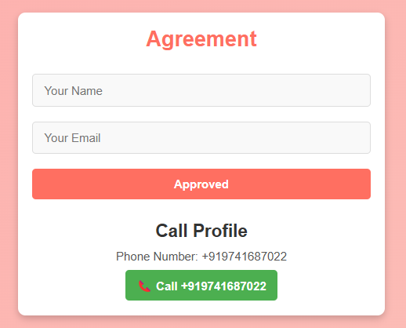
prediction of Success rate of the idea submitted using Ml Model
Approval of the idea by the Funder

Slide 10
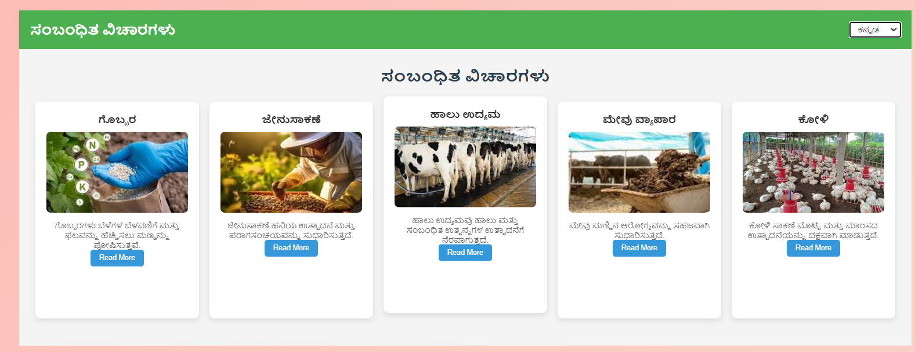
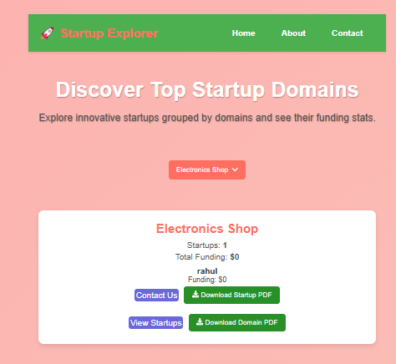
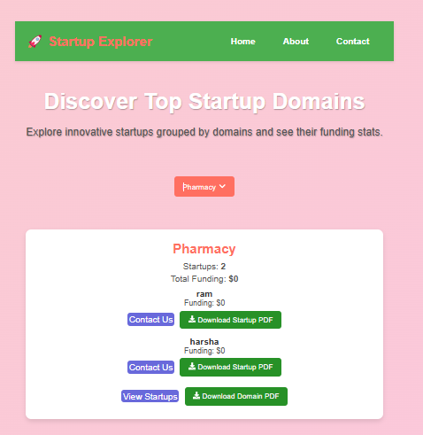
Insights Dashboard
Sorted ideas based on the idea submitted by the entrepreneur

Slide 11


FUTURE SCOPE
Integration of Advanced Machine Learning Models : As the platform matures, more sophisticated AI/ML models can be integrated to predict not only the success rate of ideas but also suggest areas for improvement in real-time based on historical data.
Natural Language Processing (NLP):Use NLP to analyze the quality of business ideas submitted by entrepreneurs, providing automatic feedback on feasibility, clarity, and market fit.
Workers for Entrepreneurs: we are going to provide a platform where we are going to provide workers for entrepreneurs
FIN - A - THON by Puttannaiah Foundation

Slide 12
Thank You
FIN - A - THON by Puttannaiah Foundation

